Slide 1
Eye Tracking to Move a Car
By Steve and Aswat

Slide 2
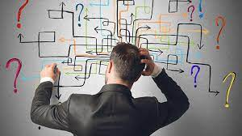
What is the Problem? (Project Description)
There are people who are born without limbs or lose their limbs due to accidents and these are people immediately lose their ability to drive a car or do most activities and we are attempting to solve one their problems with our project.

Slide 3
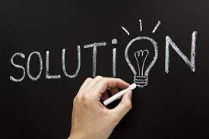
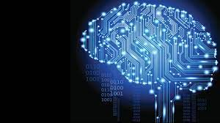
The Solution and How AI is Implemented
Our solution is to use eye movements to drive the car around as most disabled people won’t have a problem with their eyes and they will our project to move around places more easily.
AI is implemented by training a machine learning model which tells the gaze of the eyes and depending on that moves the car in a a certain direction.

Slide 4
Methodology
We first gathered the eyes of different people to use to train the model.
We then created a dataset out these eyes and split it in to train, test and valid.
We then used our dataset to create a model using tensorflow which can detect the gaze of the eyes
We then created an eye tracker using dlib library.
We then linked up the eye tracker and the gaze detection.
We then linked all of this up to ev3 so that the car can move using the gaze of our eyes

Slide 5
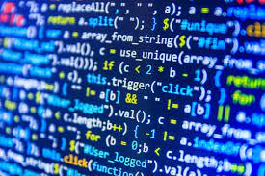
Code

Slide 6
Project Report
We set out on creating an gaze detection system which allow us to move a car. This would be very helpful to multiple people who don’t have limbs and we almost complete on what we set out to do with a completed eye tracker and machine learning model at set up and ready to go and help other people.

Slide 7


